Slide 1

TRMTracker
Setup Contract
Confidential and Proprietary. Not to be shared with third party without written consent of PioneerSolutions.
@2002-2013 PioneerSolutions LLC. All rights reserved.
@ 2002-2007 PioneerSolutions LLC. All rights reserved.

Slide 2

Setup Contract
@ 2002-2013 PioneerSolutions LLC. All rights reserved.

Slide 3
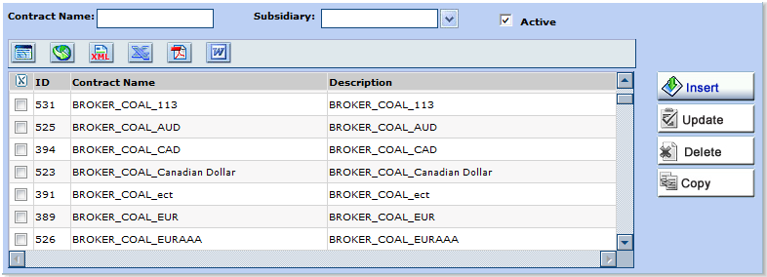
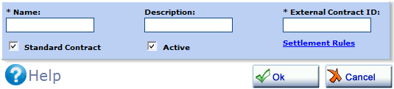
Setup Contract
Invoices and settlement calculations are run based on the contracts defined for counterparties. Steps for defining contracts are described below:
Contract Administration
Click on Maintain Contracts
Maintain Contract form opens
Click on Insert button to create new contract
Field | Description
Name | Enter a name for the contract. This is required field.
Description | Enter a description for the contract.
External Contract ID | Enter a contract id.
Standard Contract | Check the checkbox to define the contract as standard. Commodity charge will be automatically created for standard contract.
Active | Check the checkbox to define the contract as active in the system.
Settlement Rules | Click on the hyperlink to define the settlement rules for the contract. This is enabled in update mode only.
@ 2002-2013 PioneerSolutions LLC. All rights reserved.

Slide 4
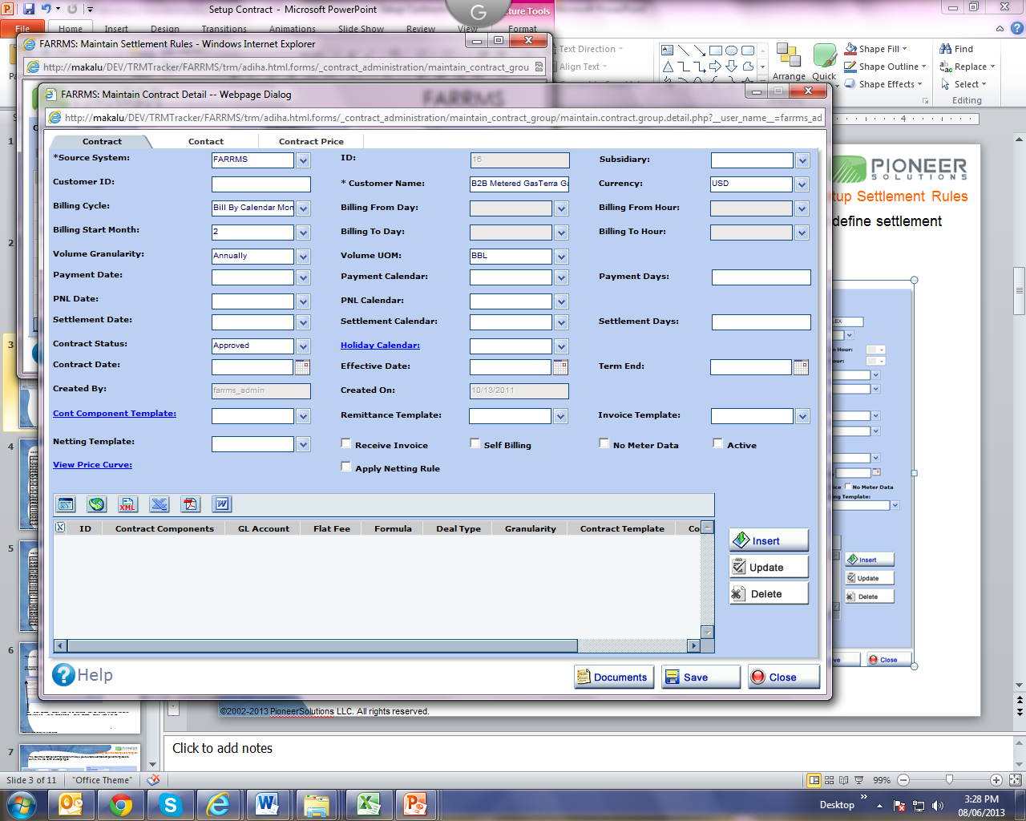
Setup Settlement Rules
Contract attributes are defined using the contract settlement rules. Define settlement rules, payment rules, line items and charge types using the following form.
Contract Administration
Click on Maintain Settlement Rules
Maintain Settlement Rules form opens
Click on Insert button to create new settlement rules for the selected contract.
Enter all the required information for the contract in contract, contact and others tab
Click on Documents button to add documents related to the contract.
Click on the Insert button to add/edit/delete contract components for the contract.
@ 2002-2013 PioneerSolutions LLC. All rights reserved.

Slide 5
Setup Settlement Rules
Contd..
Maintain Settlement Rules Detail form contains the following fields.
Field | Description
ID | This field displays the identification number of the contract. This field is disabled when creating a new contract.
Source System | Define the name of the source system for the contract. By default, FARRMS is selected.
Customer ID | Enter the identification number of the customer for whom the contract is made.
Contract Name | Define a name of the contract. This is a required field.
Subsidiary | Select a subsidiary to which the contract will belong. This is a required field.
Currency | Select a currency of the contract.
Billing Cycle | Select the billing cycle for the contract. By default, Bill By Calendar Month is selected.
Billing From Day | Select the billing start day for the contract. This field is enabled only when selecting User Defined in the Billing Cycle field.
Billing To Day | Select the billing end day for the contract. This field is enabled only when selecting User Defined in the Billing Cycle field.
Billing From Hour | Select the billing start hour for the contract. This field is enabled only when selecting User Defined in the Billing Cycle field.
Billing To Hour | Select the billing end hour for the contract. This field is enabled only when selecting User Defined in the Billing Cycle field.
Billing Start Month | Select the month in which the billing cycle begins.
Volume Granularity | Select the volume granularity for the contract.
Volume UOM | Select the unit of measurement of the volume associated with the contract.
Payment Date | Select a payment rule to specify the month which the invoice should be paid, eg. "Month+1 Working day" means next month working day.
Payment Calendar | Select a payment calendar to specify invoice payments dates in a month.
Payment Days | Enter a payment day to specify the day of the payment month selected in payment rule.
PNL Date | Select a PNL date that will show in settlement reports.
PNL Calendar | Select a PNL calendar which will show PNL dates in settlement reports accordingly.
Settlement Date | Select a settlement rule to specify which month deals should be invoiced eg. "Month+1 Working day" means next month working day.
@ 2002-2013 PioneerSolutions LLC. All rights reserved.

Slide 6
Setup Settlement Rules
Contd..
Maintain Settlement Rules Detail form contains the following fields.
Field | Description
Settlement Calendar | Select a settlement calendar which will show settlement dates in the settlement reports accordingly.
Settlement Days | Enter a settlement day to specify the day of the invoicing month.
Contract Status | Define the approval status of the contract. By default, Approved is selected.
Holiday Calendar | Define a holiday calendar for the contract. Clicking on the hyperlink allows the user to view the details of the selected holiday calendar.
Contract Date | Define the contract date.
Effective Date | Define the date on which the contract will take into effect
Term End | Define the term end date of the contract.
Created By | This field displays the name of the user who created the contract. This field is disabled when a new contract is being created.
Created On | This field displays the date on which the contract was created. This field is disabled when a new contract is being created.
Receive Invoice | Check the checkbox to define that the invoice is to be received by the counterparty.
No Meter Data | Check the checkbox to define that meter data should not be calculated.. Note: This field is applicable only for transactions associated with environmental products.
Cont Component Template | Select a template to be used for contract components. Templates for contract components are created using the Contract Component Templates form. Clicking on the hyperlink allows the user to view the details of the contract component template.
Invoice Template | Define a template for generating invoice reports for the contract.
Remittance Template | Define a template for generating remittance or payment advice for the contract.
Netting Template | Define a template for generating netting report for the contract.
View Price Curve | Click on the hyperlink to view the prices.
Active | Check the checkbox to define that the contract is active in the system.
Apply Netting Rule | Check the checkbox to define that the netting rule should be applied for the contract.
Self Billing | Check the checkbox define that payment advice should be sent to counterparties.
@ 2002-2013 PioneerSolutions LLC. All rights reserved.

Slide 7
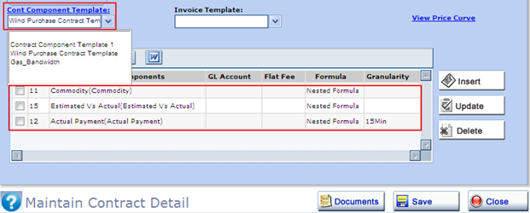
Line Items/Charge Type
Insert the line items in order to specify the contracts settlement calculation parameters. The Line items can be defined either by using existing contract component templates or by inserting new.
Select the Cont. Component Template to insert the line items(charge types). The templates are created from Contract Administration>>Contract Component Template.
@ 2002-2013 PioneerSolutions LLC. All rights reserved.

Slide 8
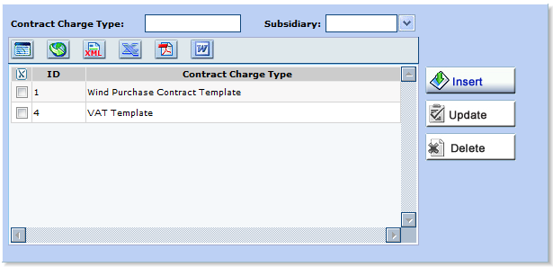
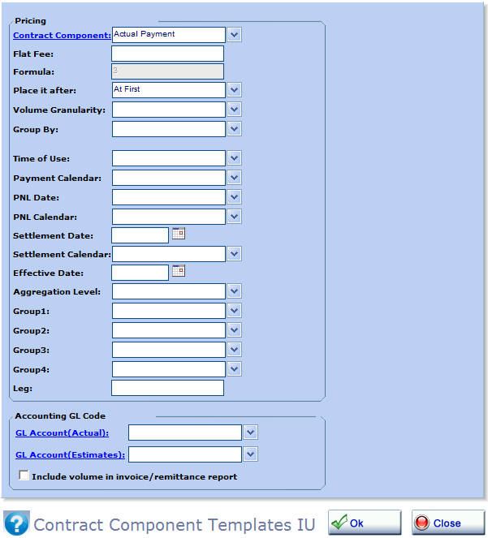
Contract Charge Type Templates
The Contract Component Templates form allows you to create contract component templates to define the line items or charge types.
Contract Administration
Click on Contract Component Template
Setup Contract Charge Type Template form opens
Click on Insert button to create new charge type template.
@ 2002-2012 PioneerSolutions LLC. All rights reserved.

Slide 9
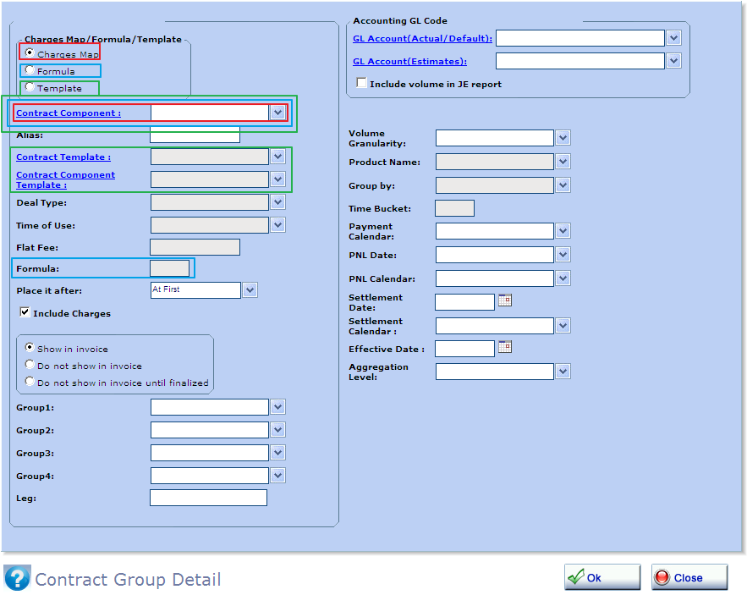
Line Items/Charge Type
New line items can be inserted by using Charge Map or Formula or Template. Click on the Insert button which opens the Contract Group Detail form.
In the Contract Group Detail form, select an option to define a line item as per business requirement:
i. Charge Map: Select this option to define a line item based on contract component mapping. Charge mapping is defined using Setup Contract Component Mapping under Setup Module. Select ‘Charge Map’ radio button, and select a contract component. This option is used for deriving values from deal settlement calculation.
ii. Formula: Select this option to define a line item using nested formula setup. This option is suitable for complex formula setup.
iii. Template: Select this option to use a pre-defined charge type from existing contract component template. This option is suitable for commonly used line items.
Select either charge type or formula or template.
@ 2002-2012 PioneerSolutions LLC. All rights reserved.

Slide 10
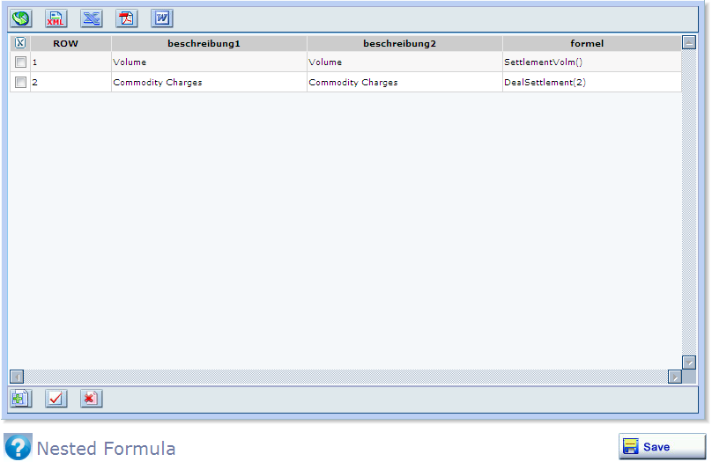
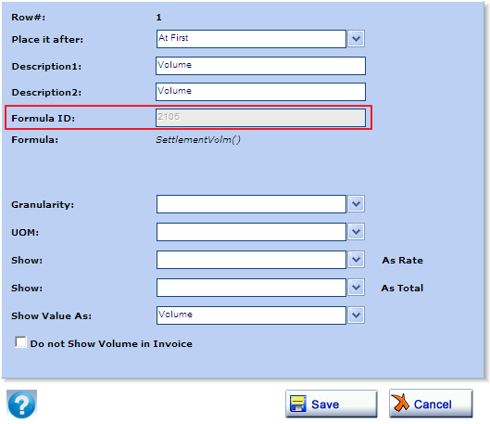
Line Items/Charge Type
Insert Formula
Nested/Complex Formulas can be added manually by clicking on the Formula field which opens the Nested Formula form.
Click on the formula field to insert/update formula.
Click on the add icon to create new formula.
@ 2002-2013 PioneerSolutions LLC. All rights reserved.

Slide 11
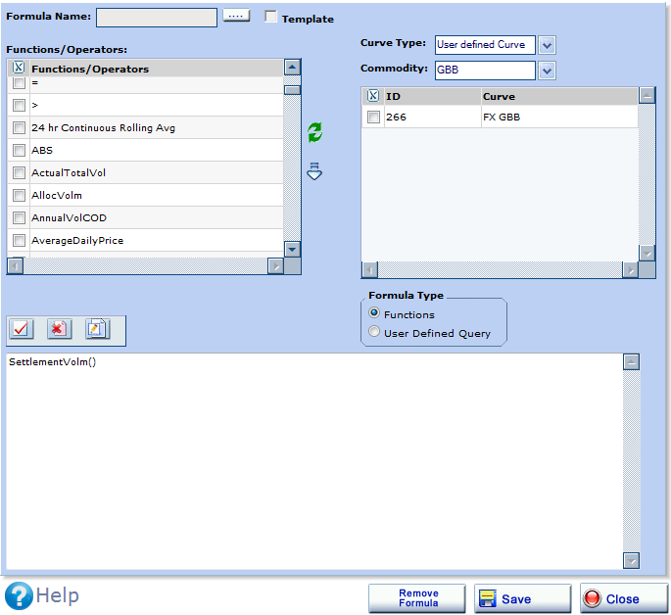
Line Items/Charge Type
Insert Formula
Clicking on the formula ID field opens following form using which formula can be inserted/created.
Select existing formula or create new formula.
Select functions/operators as per the requirement for formula
Click on verify to verify the formula inserted or delete/disable to clear formula or disable the formula textbox.
Formula textbox. You can directly type the formula in the textbox.
Click on send/reset buttons to send the selected functions/operators or curve to the formula textbox
Select a curve definition as per the requirement for formula.
@ 2002-2013 PioneerSolutions LLC. All rights reserved.

Slide 12
Maintain Transportation Contract
©2002-2013 PioneerSolutions LLC. All rights reserved.

Slide 13
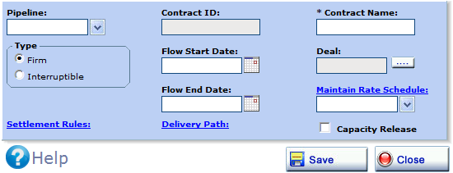
Maintain Transportation Contract
Transportation contracts are specified to the transportation deals. It captures corresponding path, rate (fees) schedule and settlement rules and other information that only applies to transportation contracts. Steps for defining transportation contracts are described below:
Contract Administration
Click on Maintain Transportation Contract
Transportation Contract form opens
Click on Insert button to create new transportation contract
Field | Description
Pipeline | Select a pipeline (Counterparty) for the contract from the drop down.
Contract ID | Displays the unique, system-generated identification number for the contract
Contract Name | Enter name for the contract.
Type | Select type of contract. Firm: Select this option to define contract type as company. Interruptible: Select this option to define contract type as clients.
Flow Start/End Date | Select start/end date of the contract.
Deal | Select transportation deals to associate with the contract .
Maintain Rate Schedule | Select a rate schedule form the drop-down.
Settlement Rules | Click on hyperlink to view the settlement rules i.e. invoice line items.
Delivery Path | Click on hyperlink to select pipeline/path.
©2002-2013 PioneerSolutions LLC. All rights reserved.

